Slide 1




Source Types and Credibility
An Introduction

Slide 2
Source Types
PRIMARY:
A source you are writing about;
We’ve used several primary sources in this class so far, including your images for the Visual Analysis, and the article for the Rhetorical Analysis;
For this essay, your primary source is your movie, book, TV show, etc.
SECONDARY:
A source you use to help you make your points (for information, ideas, supporting opinions, etc.);
This is the first essay for this class that will use secondary sources!

Slide 3


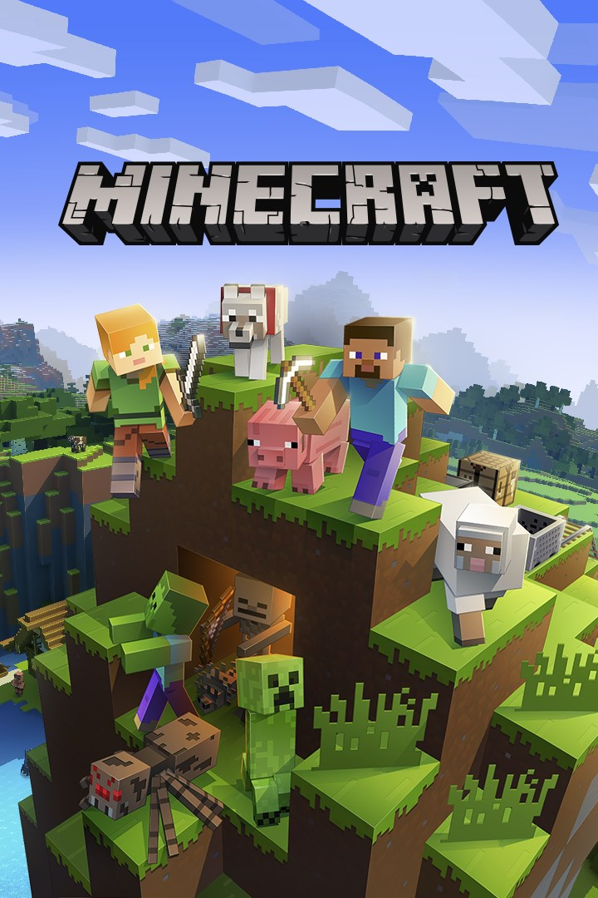


Primary Sources: A note
There are no “quality” restrictions on primary sources, since you can analyze and write about anything at all, from TV shows, to social media, to video games to architecture.

Slide 4
Secondary Source Quality: A Hierarchy
Scholarly—this is the highest quality source, as it requires the most expertise and goes through the most vetting.
Credible—this is an acceptable source; it requires some kind of expertise and goes through some vetting
Non-credible—this kind of source can never be used as a secondary source in an academic essay! It requires no expertise and goes through no vetting!

Slide 5
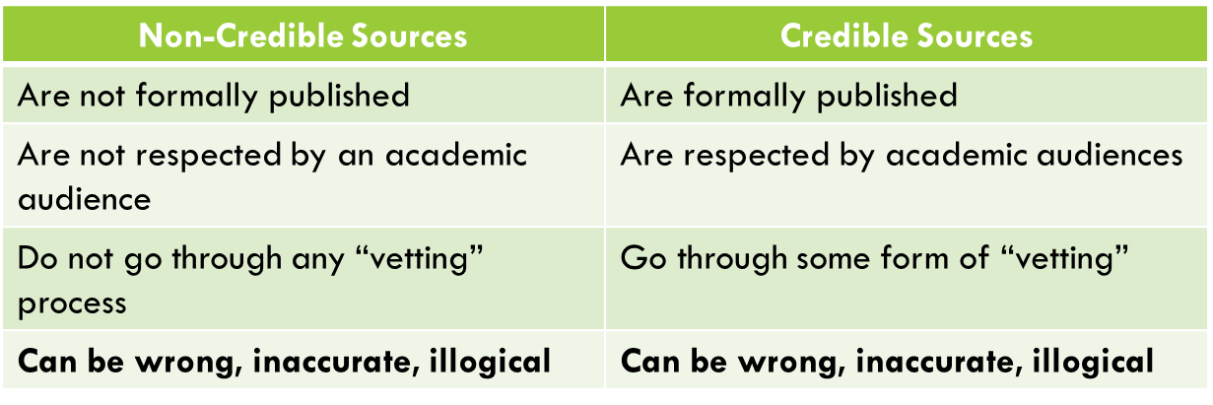
Non-Credible vs. Credible

Slide 6
Non-Credible Vs. Credible Examples
Non-Credible (DO NOT USE!) | Credible (USE!)
Wikipedia | Books
Blogs | Newspaper articles
Comment sections | Magazine articles
Personal websites | Articles published on official news or educational websites
Social media | Scholarly articles (more on this for the next essay!)

Slide 7
Non-Credible Sources
I have an idea, an opinion, or information I want to share
I start a blog, go to Wikipedia, head to a comment section, go to facebook, and write whatever I want
No one stops me! What I said goes through no vetting. It is now on the internet. It may be changed later, but for now, it’s out there!

Slide 8
Credible Sources
I have an idea, opinion, or information I want to share
I send it to The New York Times, The Wall Street Journal, and a book publisher
Several people read this piece to see if it is of high enough quality to be published; it may or may not be published
If they DO choose to publish it, it will be edited and fact-checked before it sees the light of day!

Slide 9

Non-Credible Sources: A final Word
Credible sources can be wrong (in fact, you’ll need to disagree with them sometimes)! Non-credible sources can be correct! That’s not what these terms mean (review previous slides if you need clarification).
Academic audiences have no reason to take non-credible sources seriously. In short, they are not worth our time. Think of non-credible sources as drunk people outside a bar at 3 am. Yes, they might say something interesting. Yes, you can win an argument with them. But there is just no point in engaging with them. That’s not where we go for serious conversation and thought.

Slide 10
Secondary Sources for Cultural Critique
You need a total of two secondary sources for this essay. (Please do NOT use more!) You need one of each!
Supporting—you’ll need one secondary source for this essay that helps you make your point, either by agreeing with you or supplying supportive information
Disagreeing—you’ll need one that contradicts one of your ideas; we’ll be using this for a counterargument!

Slide 11
Secondary Sources for Cultural Critique
Options for Secondary Sources
Sources about your primary source (reviews or analysis articles)
Sources about your idea/message (opinion articles or scholarly articles)

Slide 12
Modern Family Example
“While many think Modern Family celebrates diversity and nontraditional families, it actually sends the regressive message that families function better when women stay home.”
She used a secondary source that agreed about her idea, and talked about how problematic messages like these are for women.
She used a secondary source that disagreed with her about the message the show was sending (this was a review of the show that said Modern Family had an empowering message about women)

Slide 13


Finding Sources
Reviews: we live in the golden age of reviews! People review seasons, episodes, and series constantly. Two great websites for finding reviews of TV, music, movies, or video games are Rotten Tomatoes and Metacritic. They are databases that collect credible reviews from around the web and put links to all of them on one page.
Ideas: Let’s get into databases! We’re going to start with a database called Academic OneFile (see instructions on the next page). This returns credible results from a variety of sources when you put in a topic like “stereotypes women television.” You can search any topic here!

Slide 14
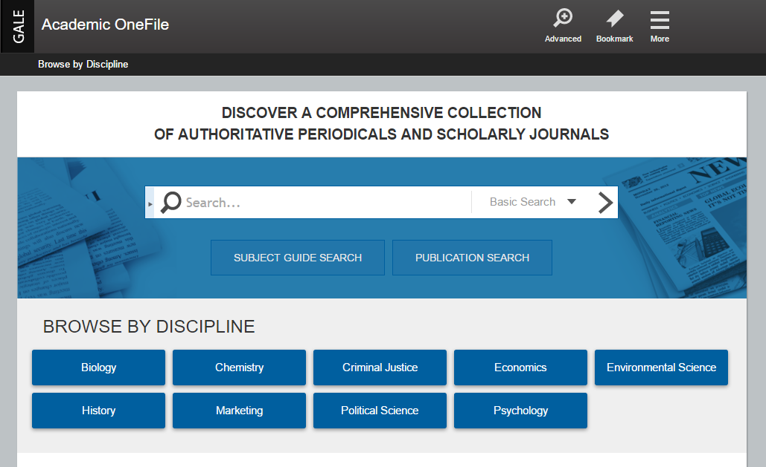
Academic One File Instructions
1. Go to the Montgomery College homepage and click “Library”
2. Under “Research and Access” click Databases “A to Z”
3. Click “Academic One File”
4. Search for whatever you want, knowing ALL results will be credible!

